Slide 1
Designing For The
NESDAC Stack
Sandia National Laboratories, CA
University of Utah
November 8, 2026

Slide 2
Outline
Architecture
Common design requirements
Examples

Slide 3
Modular hardware architecture
C
O
M
M
O
N
B
U
S
Sensor
Processor
Smart modules – Each module:
  Is capable of operating independently
  Has a processor and a specialized resource
  Resides on a common bus
  Is optimized for its task
Physically and operationally modular
Radio
Processor
Data
Storage
Processor
Power
System
Processor
Notes:
Note that this is different from commercial solutions that are only physically modular- the tmote sensor board can’t do anything without the main tmote board.

Slide 4
Inter-module Bus
Supports a variety of communication schemes
Has regulated and unregulated power supplies
Unused lines left undefined for future expansion
Unregulated Power
Regulated Power
Serial Communications
Parallel Communications
General Purpose I/O
Expansion

Slide 5
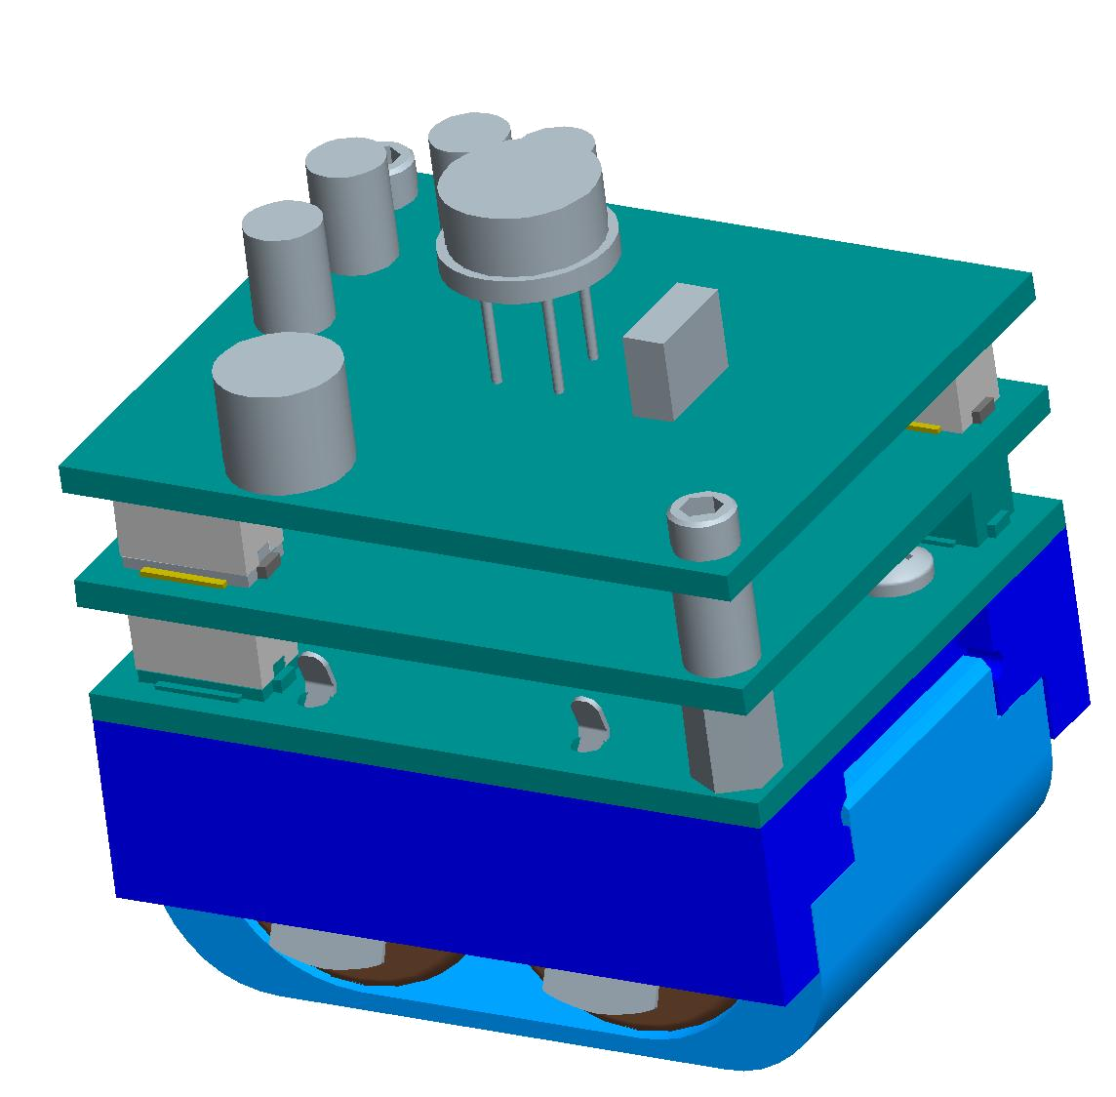
Module Form Factor
Custom battery holder defined module size as 1.25”x1.5” (based on batteries)
Board to board spacing of either 3.5 or 5 mm
  Limit components to:
    3.5 mm tall on top
    1.5 mm tall on bottom
Size suitable to most applications
0.3”
0.6”
1.25”
1.5”
Notes:
Able to fit CR2s or 2/3AAs.
You can always put something small in a larger space- the converse is not true. This is small enough for reasonably covert distribution.

Slide 6
Connector Pinouts
2 x 20 pin connectors on each side of the module
  3.3V and VBatt, 3 pins each for current
  6 ground pins
  I2C clock (SPI clock), I2C data (slave out), master out, slave enable, open-drain interrupt line
  UART Rx and Tx
  One 8-bit port (interruptible)
  13 more GPIO
Exact definition shown later

Slide 7
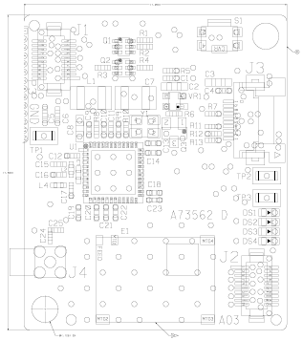
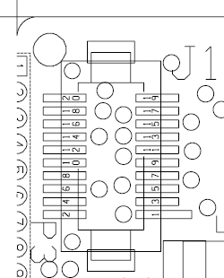
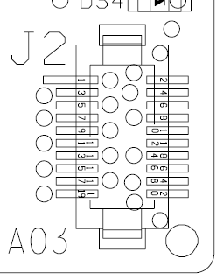
Connector Footprints
Pins pass straight through the board
P1 directly under J1, P2 under J2
Cannot be plugged together incorrectly
May require two different footprints for top and bottom
J1, P2 are plugs
J2, P1 are sockets

Slide 8
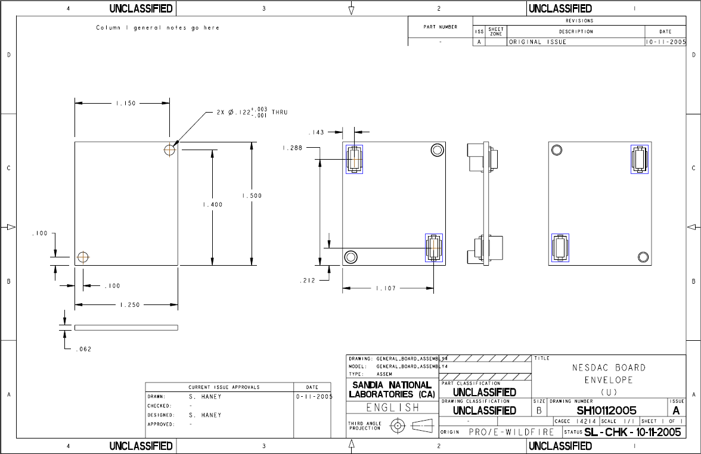
Mechanical Specifications

Slide 9

Powering the Stack
Provide battery power to each module over the bus
  Each module must use a filter on the power lines
Regulate a low-current common voltage for communication standardization
Microcontroller can monitor battery voltage
Use CR2’s or 2/3AA batteries
  Available in several varieties (LiMNO₂, LiSOCL₂)
  Helped to define the form factor shown earlier
  Capable of high current as well as long life
B
U
S
Local power mgmnt.
MCU
3.3V
Boost
Converter
Comms
Level
Translation
MCU
Notes:
Form factor was designed to accommodate either battery choice.
Part of this design required the communications analysis that will follow in a few slides.
Allowing each module to optimize its power use lowers overall power consumption.
Even though there may be an LDO on each module, the overall overhead is still less than a centralized power solution.
For example, each LDO may require 2uA to run, but can supply 0 to 50mA.
If four modules each had peak requirements of 50mA, a centralized solution would need to provide the capability of 200mA.
LDOs capable of this current are much less efficient (10’s of uA overhead).
Also, any centralized design would require designing to the highest requirements (what if we foresaw a need for 10 modules? A DSP?).
Decentralization avoids these issues.

Slide 10
Communicating over the Bus
Serial communication
  I2C or SPI
Several GPIO lines included
Room for expansion
Use a 3.3V reference and level translators to standardize communication
  3.3V boost converter required on power supply
  Low output current, very low Iq converters are available
  I2C requires special translators
Local
Resource
Battery Power
B
U
S
Local Power
Management
+Vbatt
+Vdd
+3.3V
MSP430
MCU
I2C
SPI/I2C
Level
Converter
I2C
SPI
SPI
8-bit I/O
8-bit
Level
Converter
8-bit I/O
Local Power
3.3V Power
Notes:
Chose 3.3V since there are still a lot of electronics that can’t reach the 1.8V level, and 2.5V isn’t much different than 3.3V, but would exclude some 3.3V parts.
Low Iq boost converters are available, but always test them!
Special care was needed to select a converter capable of operating to at least a 3.3V input (100% duty cycle) and preferably able to accept or pass up to 3.6V.
I2C is open-drain- most bidirectional level shifters don’t accept this. FETs are a cheap and effective solution.

Slide 11
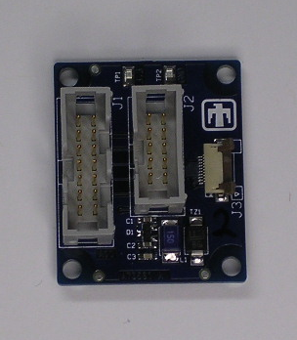
Programming Modules
Separate programming header on each module
Adapter board connects to header
  Allows in-circuit programming and debugging of modules
  Also has RS-232 interface
Programming requires higher voltages
  Plugging in the programming adapter bypasses local power regulation
Programming Adapter

Slide 12
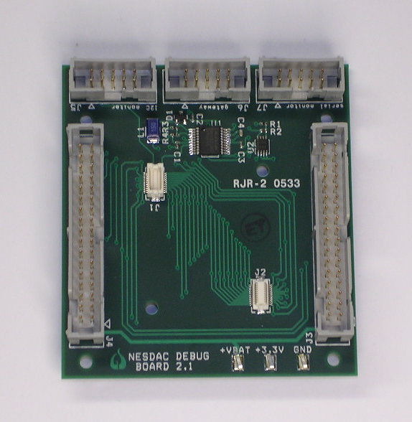
Debugging the Stack
Early versions of the stack were difficult to debug
  Bus was hard to get to, hard to watch in real time
“Debug board” breaks out inter-module bus
  Allows boards to be cabled together flat on a table for easy access
  Bus can be monitored easily
Each module can be programmed and debugged individually and simultaneously.
Debug board

Slide 13
General Module Design
Local power regulation
Local power filtering and decoupling
Serial communication level converters
GPIO level converters
Resource
B
U
S
Vdd
Local Power
Supply
+Vbatt
Micro-
controller
I2C, Vdd
SPI/I2C
Level
Converter
I2C, 3.3V
SPI, Vdd
SPI, 3.3V
8-bit I/O, Vdd
8-bit
Level
Converter
8-bit I/O, 3.3V
Notes:
RTOS running at a 50Hz tick (very fast) in the above numbers.
Transmitting once a minute average to about 7.5uA.

Slide 14
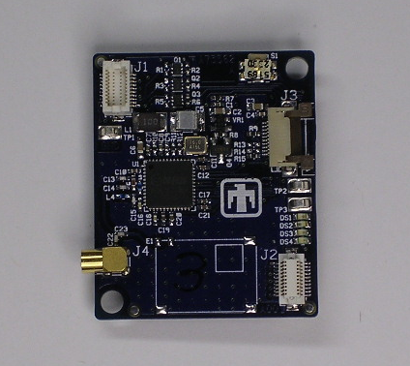
Example - Radio
CC2420
Radio
Uses MSP430F1611 and Chipcon 2420
  2.4GHz 802.15.4 compliant
  Hardware encryption
  DMA on microcontroller creates very fast interface
Power consumption
  2 μA in full sleep mode
  3.5 μA with RTOS
  +2 μA for each packet transmitted per 2 minutes
  Average of 5.5 μA (16.5 μW) in operation
B
U
S
2Mbit DMA SPI
1.8V
1.8V
LDO
+Vbatt
MSP430
MCU
I2C, 1.8V
SPI/I2C
Level
Converter
I2C, 3.3V
SPI, 1.8V
SPI, 3.3V
8-bit I/O, 1.8V
8-bit
Level
Converter
8-bit I/O, 3.3V
Notes:
RTOS running at a 50Hz tick (very fast) in the above numbers.
Transmitting once a minute average to about 7.5uA.

Slide 15
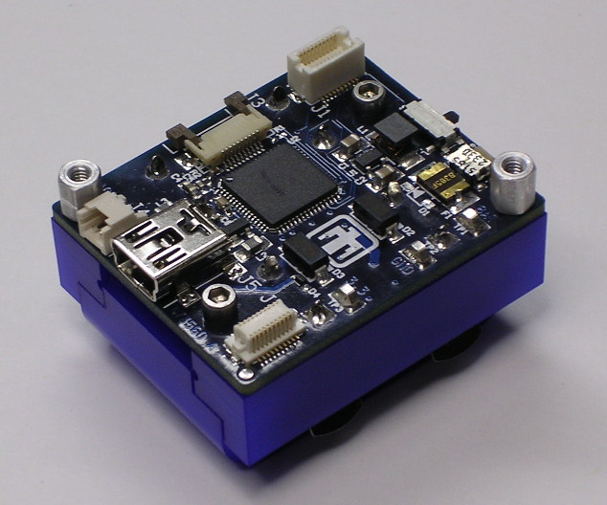
Example - Power Supply
B
U
S
Batteries
+Vbatt
Provides a regulated 3.3V supply
  Used to provide a standard communication voltage between modules only
MCU monitors for low battery voltage
USB connection
  Provides external power
  Communication with a gateway computer
  Completely disconnected when not in use
Consumes only 3.5 μΑ (10.5 μW)
  5x improvement over Gen. 2
Voltage
Monitor
3.3V
Boost
Converter
MSP430
MCU
3.3V
3.3V
I2C, 1.8V
SPI/I2C
Level
Converter
I2C, 3.3V
SPI, 1.8V
SPI, 3.3V
UART
USB
Controller
USB
Notes:
MCU allows monitoring of the bus, switching batteries on and off, low voltage monitoring, etc.
Can be completely shut down (.1uA) if not needed.

Slide 16
Serial Communication
SPI
  Multiplexed I2C lines with SPI
  Applications can use either, but not both
  Faster, up to ½ processor clock
  Slaves must request service from the master
    Requires interruptible GPIO lines (1 per slave)
    Slaves require individual enable lines or an addressing scheme in the packet structure
  Disadvantages:
    No built-in acknowledgement like I2C
    No hardware addressing, start/stop, etc.
    Not multi-master
    Uses many bus lines
Converted to 3.3V with FETs
  Wastes some energy due to pull-ups

Slide 17
Serial Protocol
Flexible packet structure:
  Destination (2 bytes)
  Source (2 bytes)
  Message ID (1 byte)
  Command (1 byte)
  Payload length (2 bytes)
  Payload (N bytes)
  Checksum (1 byte)
SPI allows use of DMA for transfers (2Mbit/s)
  DMA can only execute a specified number of times
  Variable length packets are problematic
  Packets are temporarily filled out to a preset length

Slide 18
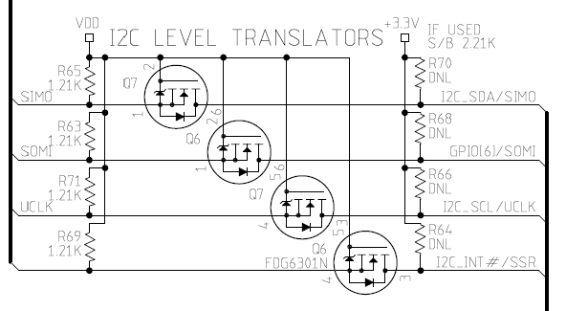
I2C/SPI Level Translation
FETs allow open-drain operation.
3.3V pull-up resistors
  Footprints on every board
  Loaded in only one location (generally the power supply)

Slide 19
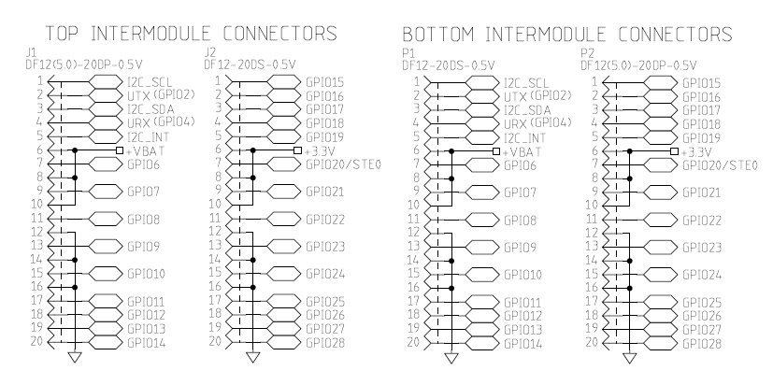
Current Connector Pinout
Includes I2C/SPI, interrupt line, UART, 1 slave enable, GPIO, power.
SPI: SIMO on I2C_SDA, SOMI on GPIO6, UCLK on I2C_SCL

Slide 20
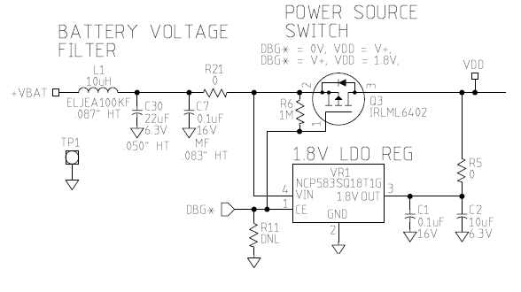
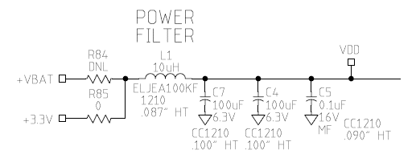
Power Circuits
Local power regulation with programming bypass. DBG* is pulled low when the programming adapter is plugged in. Load R11 with 0 ohm to force bypass.
Selectable power source with filter.

Slide 21
5mm
38mm
10mm
18mm
5mm
7mm
23mm
20mm
32mm
18mm
32mm
38mm
7mm
5mm
10mm
5mm

Slide 22
U of U Project Goals
Design, build, test a custom expansion board.
Unit should answer three questions:
  Where are you now?
  How did you get there?
  Did you leave your approved path?

Slide 23
Applications
Inventory tracking.
  Where is it?
  Why did it take so long?
  Was it tampered with?
  Authentication.
People tracking.
  Where’s Mackler?
  Cars.

Slide 24
Top Level Requirements
Must be compatible w/the NESDAC.
  Independent operation
  Communication
  Power consumption
Must continue to answer the three questions without wireless comm.
Must provide a good user interface.

Slide 25
Task Breakdown
Embedded GPS/IMU solutions.
uProcessor programming.
Memory / interface.
Circuit design.
Board layout, fab & loading.
PC interface.
IMU algorithm, power usage scheme.
DOCUMENTATION!

Slide 26
What do you need?
Exact form factor for the boards, possible layout blank.
Communication protocol details
Partial schematics for NESDAC compatibility.
Possibly some programming boards, extra components, etc.

Slide 27
Schedule
October 17-19: Conceptual Design Review
End of Dec: Final Design Review
March 1: Functional Hardware
End: Testing programming/interface, etc.

